Slide 1
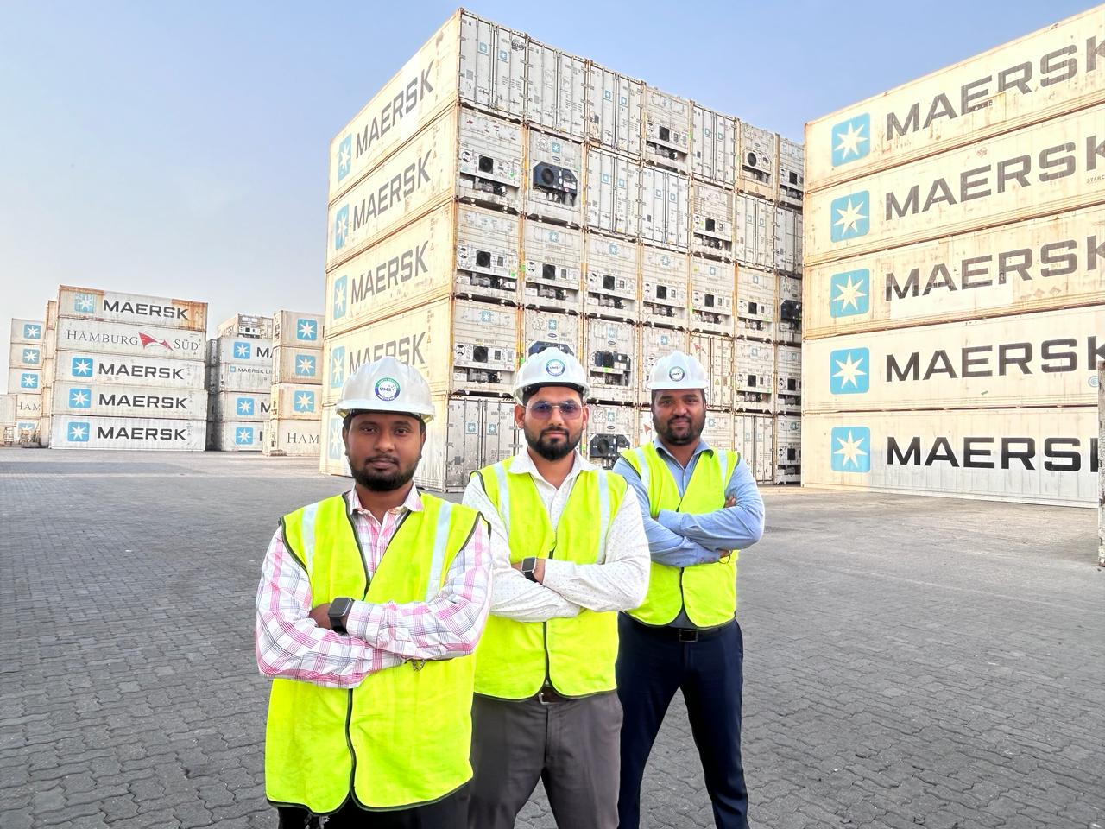
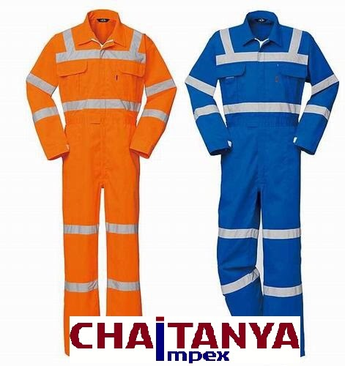
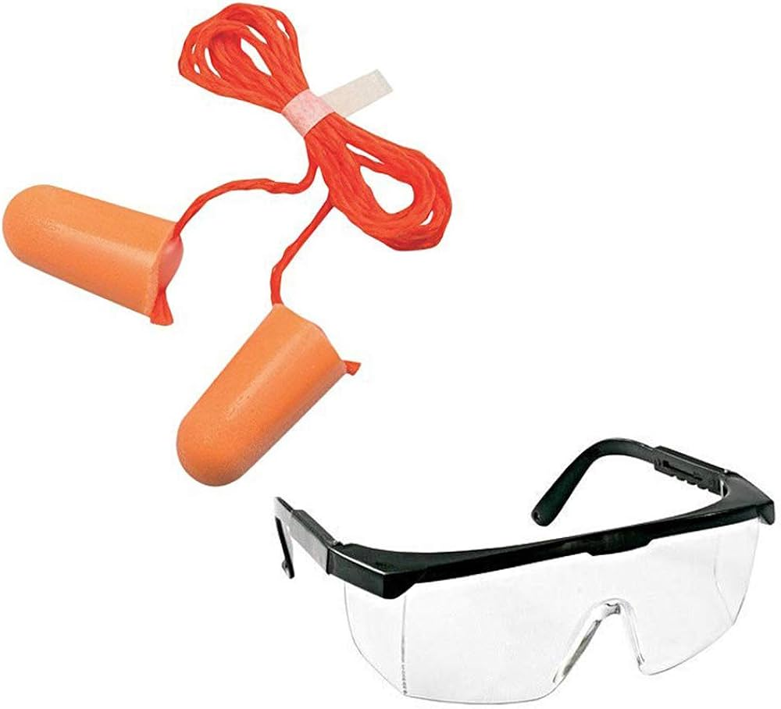

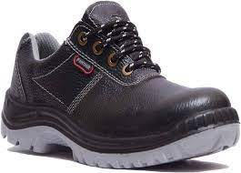
Committed to Health & Safety
KMS Management considers Health, Safety and Environment as the key business concerns in today's World.
The right approach by the KMS Management helps us to control risks, cut costs and get a competitive edge.

Slide 2
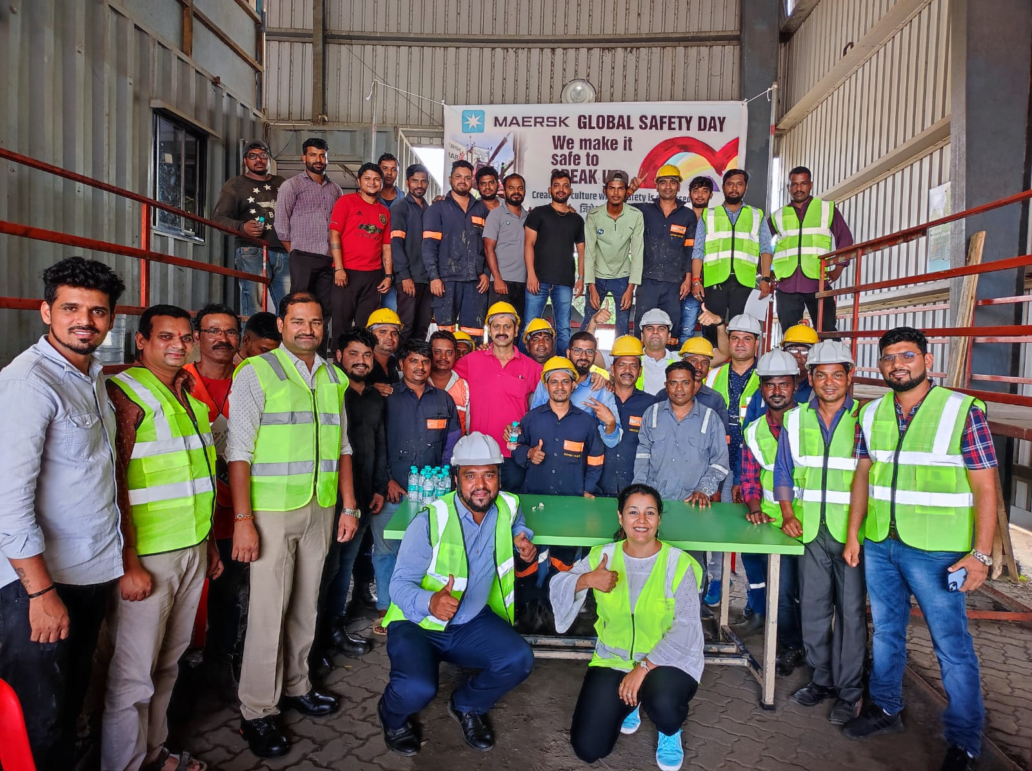
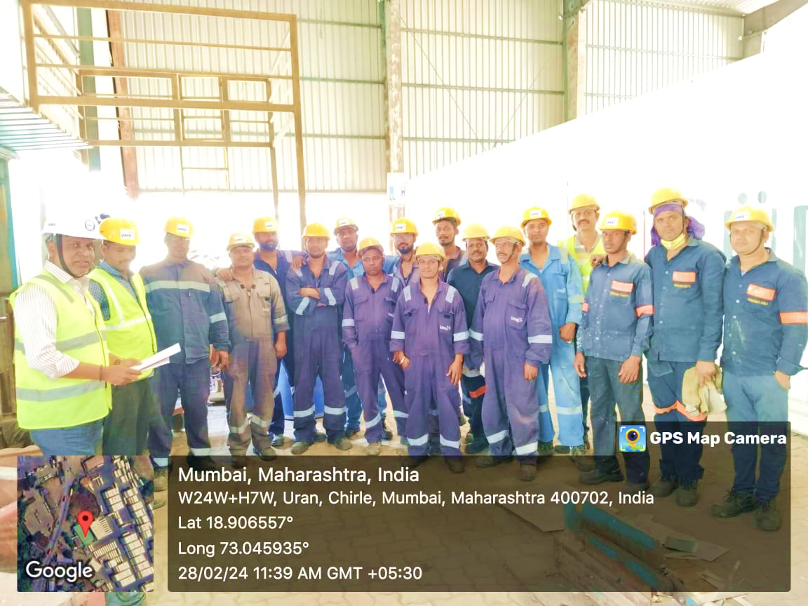
Committed to Worker Welfare

Slide 3

Committed to Customer Safety Satisfaction

Slide 4
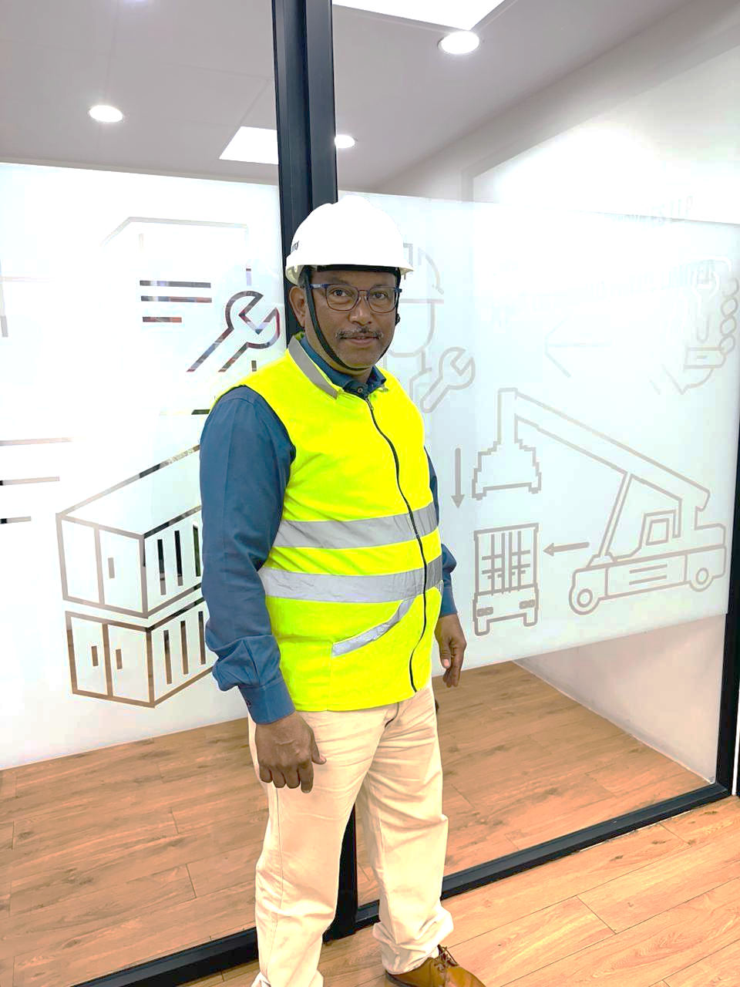

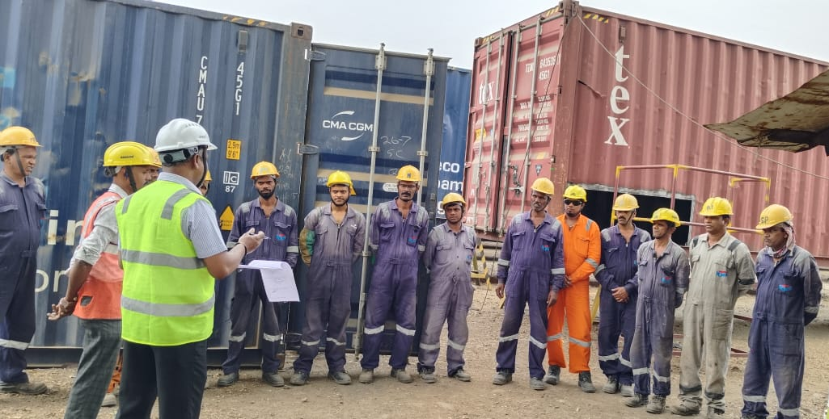
HEALTH SAFETY & ENVIRONMENT MANAGEMENT
By taking a methodical approach, our Safety Management Team was able to help the business comply with all regulations, make sure that all of our subcontractors' & employees understood their responsibilities regarding everyone's health and safety, and help create a safe and positive work environment.

Slide 5

KMS MONDIALLE PVT LTD
Container Seals I Maintenance & Repair I Trucking
KMS MONDIALLE.Pvt.Ltd. is committed to provide safe and healthy working conditions for the prevention of work-related injury & continually improve the Health, Safety & Environment system for the benefit of employees and stakeholders.
In our endeavor to achieve this KMS shall:
Set objectives and targets In Health, Safety & Environment system and practices aimed to preventive steps.
Provide sufficient resources in term of Finance, Information, Training & Supervision for the effective implementation and communication to all levels in the organization and external parties through website, social media, email etc.
Recognize & promote the commitment and co-operation required at all levels.
Comply with all the relevant legislative, regulatory and voluntary requirements.
Hold all the levels of management accountable for Occupational Health & Safety matters in the area of responsibility.
Enhance customer satisfaction through creation of safe and healthy work environment.
This policy is based on the fundamental belief that all work related injuries and illness are avoidable. There is no task that we undertake which is so important that we cant take time to find a safe way to do it.
This policy will be revised whenever circumstances indicate a review is necessary.
Jagdish Khanna
Managing Director
KMS MONDIALLE PVT LTD

Slide 6
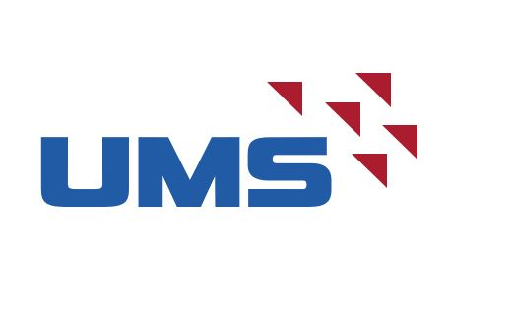
UNICON MARINE SERVICES LLP
Container Maintenance & Repair
UNICON MARINE SERVICES LLP. is committed to provide safe and healthy working conditions for the prevention of work-related injury & continually improve the Health, Safety & Environment system for the benefit of employees and stakeholders.
In our endeavor to achieve this UMS shall:
Set objectives and targets In Health, Safety & Environment system and practices aimed to preventive steps.
Provide sufficient resources in term of Finance, Information, Training & Supervision for the effective implementation and communication to all levels in the organization and external parties through website, social media, email etc.
Recognize & promote the commitment and co-operation required at all levels.
Comply with all the relevant legislative, regulatory and voluntary requirements.
Hold all the levels of management accountable for Occupational Health & Safety matters in the area of responsibility.
Enhance customer satisfaction through creation of safe and healthy work environment.
This policy is based on the fundamental belief that all work related injuries and illness are avoidable. There is no task that we undertake which is so important that we cant take time to find a safe way to do it.
This policy will be revised whenever circumstances indicate a review is necessary.
Sunil Khanna
Managing Partner
Unicon Marines Services LLP

